Slide 1
Copyright © 2014 by Software Craftsmanship Guild.
All rights reserved. No part of these materials may be reproduced, distributed, or transmitted in any form or by any means, including photocopying, recording, or other electronic or mechanical methods, without the prior written permission of the Software Craftsmanship Guild. For permission requests, write to the Software Craftsmanship Guild, addressed “Attention: Permissions Coordinator,” at the address below.
Software Craftsmanship Guild
526 S. Main St, Suite 609
Akron, OH 44311

Slide 2
Query Strategies
Software Craftsmanship Guild

Slide 3
Lesson Goals
Learn how professionals handle building complex queries

Slide 4
Steps to Building Queries
Organize
First go through the tables and make a list of all of the tables and fields that contain the data you are looking for
Join
Build all of the table joins working with a select * statement
Filter
Add any filter statements necessary to your where clause
Itemize
We rarely need everything, go back to your select * and swap it out for just the fields required

Slide 5
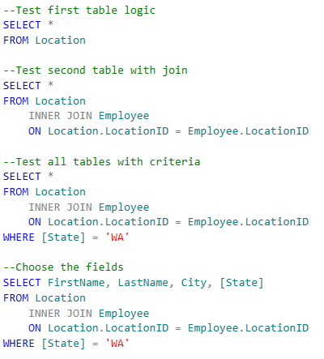
Example
Let’s say we want to get the FirstName, LastName, City, and State for our corporate employees located in Washington

Slide 6
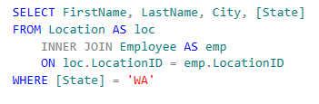
Table Aliasing
Using the AS keyword, we can alias a table name to save some typing.

Slide 7
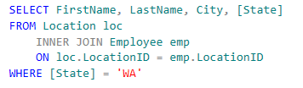
The AS is actually optional
This is also valid. Ultimately follow the pattern your team sets

Slide 8
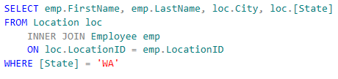
Aliases Work in the Select List as Well
It is only required when you have the same field name in both tables so the server knows which column you want. (“Ambiguous error”)

Slide 9
And now for something different
Cross Joins and Unmatched Queries

Slide 10
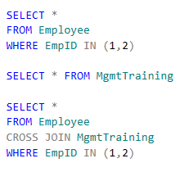
CROSS JOINS
Sometimes we don’t have a relatable field between tables, but we are looking for every combination between records in tables.
In this case we can use a CROSS JOIN, also known as a Cartesian Combination
It basically reads as “give me every possible combination of records between the two tables
Try the queries to the right in SWCCorp

Slide 11
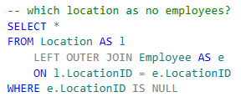
Unmatched Records Queries
This is a common SQL pattern. We have a table with a list of elements that is optionally joined to another table.
We want to know which elements in the first table has no matches in the second.
LEFT JOIN and check for NULL!

Slide 12
Lab Exercises (SWCCorp)
Write a query to show every combination of employee and location.
Find a list of all the Employees who have never found a Grant

Slide 13
Fin
Next up- Data Definition Language

